Slide 1
Parallel Acceleration of FP-Growth construction
312554052 徐劭廷
312551152 楊鎮綸
312581010 孟羽真
Notes:
13組

Slide 2
Outline
Introduction/motivation
Proposed solution
Evaluation
Conclusion

Slide 3
Outline
Introduction/motivation
Proposed solution
Evaluation
Conclusion

Slide 4
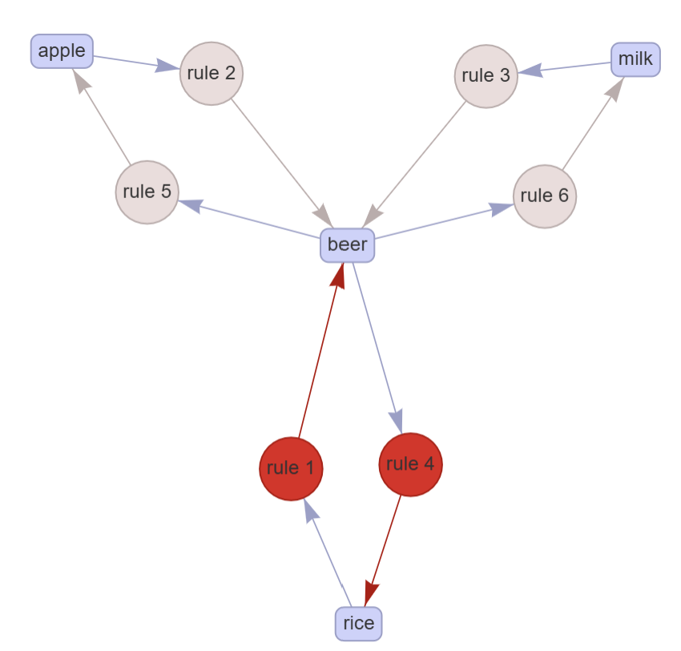
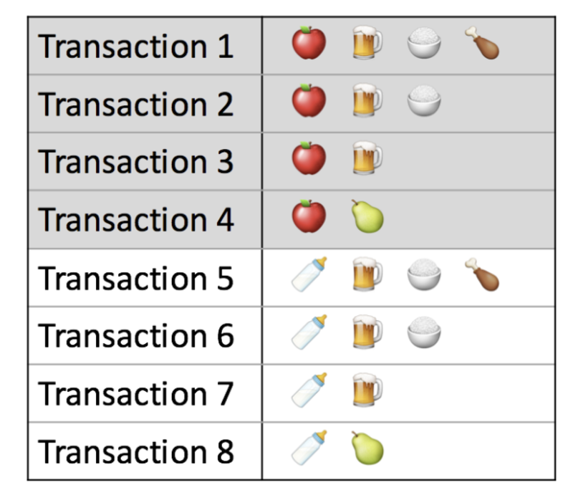
Introduction
Discovering the frequent itemsets and association rules
Notes:
發現頻繁項集和發現關聯規則 看似沒有關聯的兩項商品, 其實之間是有購買規則的

Slide 5
Overview of FP-Tree algorithm
Step 1 - Calculate Minimum support
Step 2 - Find frequency of occurrence
Step 3 - Prioritize the items
Step 4 - Order the items according to priority
Step 5 - Build Fp-tree

Slide 6
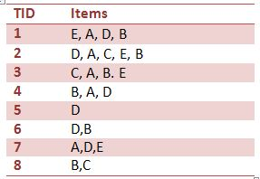
Step 1 - Calculate minimum support
First should calculate the minimum support count.
Suppose minimum support should be 30%
Minimum support count is ceiling (30/100 * 8) = 3

Slide 7
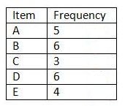
Step 2 - Find frequency of occurrence
Find the frequency of occurrence of each item in the Database table

Slide 8
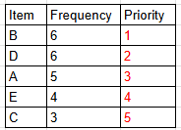
Step 3 - Prioritize the items
Those are the priority of each item according to it's frequency of occurrence

Slide 9
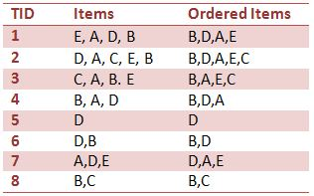
Step 4 - Order the items according to priority
Sort the items in each transaction according to Step 3
Remove items that do not meet the minimum support requirement

Slide 10
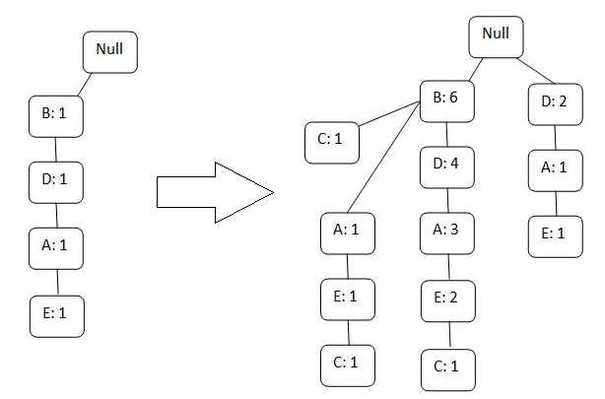
Step 5 - Build FP-tree
Build the root node and attach the items of the row 1 one by one respectively
Write their occurrences in front of it

Slide 11
Motivation
The sequential scan of all transaction datas to
Count the frequency of each item
Build the global FP-tree and update the information on all the trees
=> Very slow
Those phases are highly suitable for parallel processing
Notes:
在統計每個item出現次數時, 序列作法很花時間
建樹時, 需要一筆一筆資料去做處理很花時間
這兩階段很適合做平行化處理

Slide 12
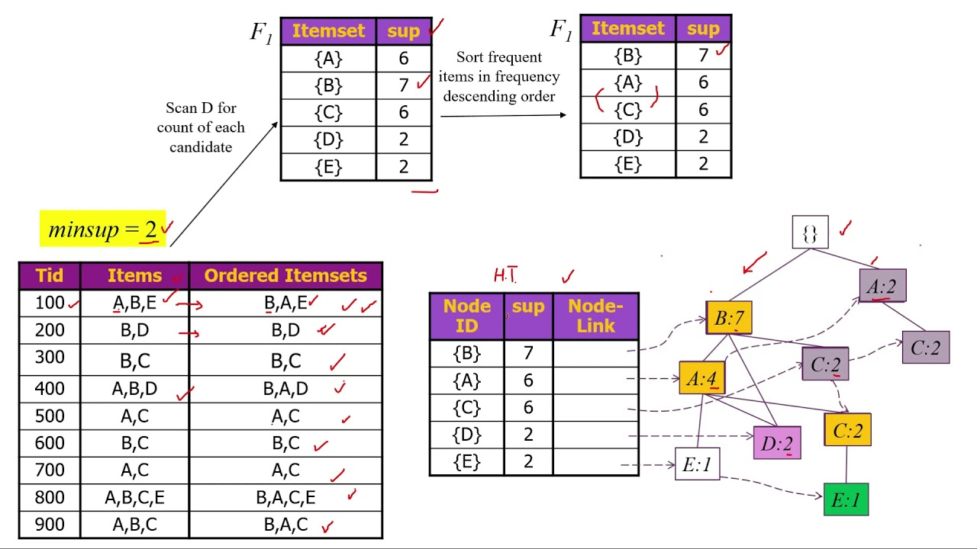
FP-Growth Algorithm
FP-Growth Algorithm
The FP-Growth algorithm uses an FP tree to compress data, share common item set parts, and recursively extract frequent item sets

Slide 13
Outline
Introduction/motivation
Proposed solution
Evaluation
Conclusion

Slide 14
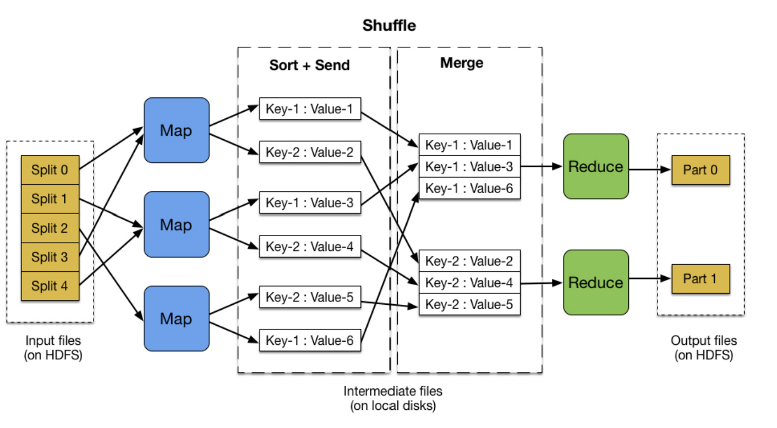
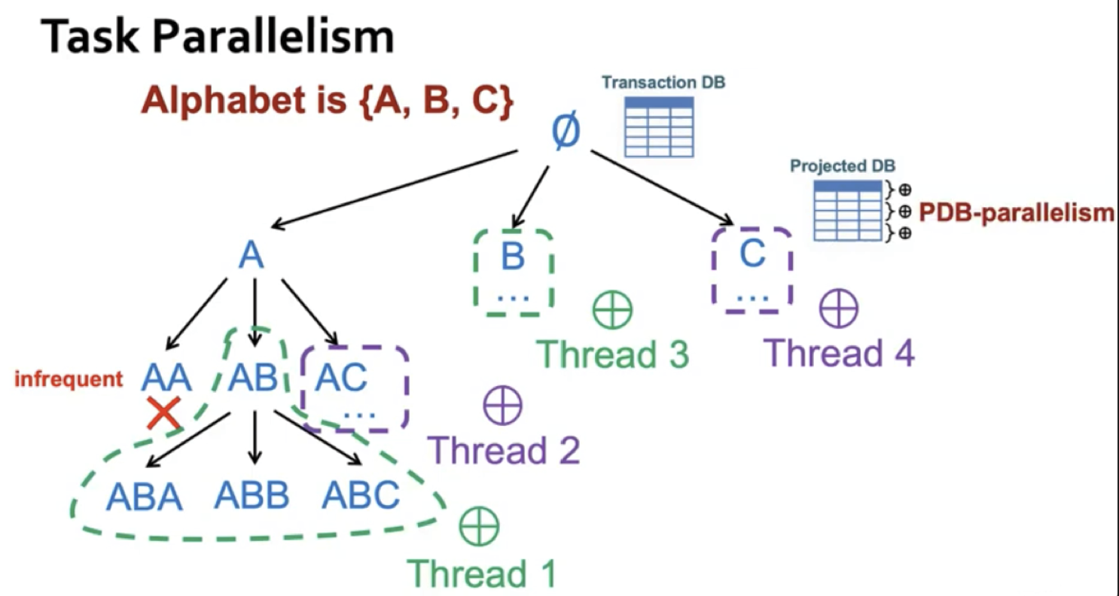
OpenMP - Map Reduce method
Data Compression
Each mapper scans a portion of the dataset and
identifies local frequent itemset , which are
then merged into global list
Tree Construction
Each node creates a sub-FP-Tree by inserting
transactions into the tree, which are
then merged into a complete FP-Tree
Notes:
OpenMP 利用 map reduce 加速，平行化分成兩部分
1. 掃過所有資料建立 frequency item
|- map: 每個 thread 計數分配到的部分資料的各自計算 item 出現次數
|- reduce:在將所有 thread 計數好的 local item 數量 merge 在一起
2. 根據建好的 frequency item，去建立 fp-tree
|- map: 每個 thread 建立分配 fp-tree 子樹
|- reduce: 獎每個 thread 建立的子樹 merge 成一 global fp-tree

Slide 15
MPI - Map Reduce method
Item frequency
Each processor processes its own local item frequency, which is sent to the Master and accumulated into the global item frequency
The Master removes items smaller than the threshold and broadcasts them to all processors
Tree Construction
Each processor sorts the transactions it processes, and then checks the items in order to insert nodes along the local root. Send sub-fptree to Master to merge into a complete FP-tree
Notes:
item:
每個處理器負責的交易數 local_transaction_count 根據 total_transactions / world_size 計算，餘數由排名靠前的處理器處理。
每個處理器只處理自己分配的交易範圍，計算各自的 item frequency，儲存在 local_frequency_by_item 計算完後把結果 send 到 Master(global item frequency)。master 會再將 frequency < threshold 的 item 移除掉，並 broadcast 至所有 processors。
tree:
每個處理器皆初始化一個 local root ，接著根據自己負責的交易依序檢查 item，沿著 local root 插入 node。
建構完各自的sub-fptree 後，sned 至 Master 作 merge fptree。所有處理器使用 MPI_Barrier 保證完成所有步驟後同步。

Slide 16
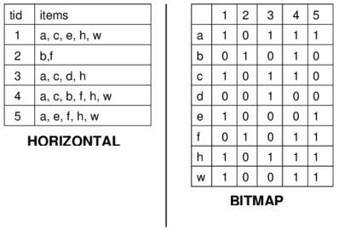
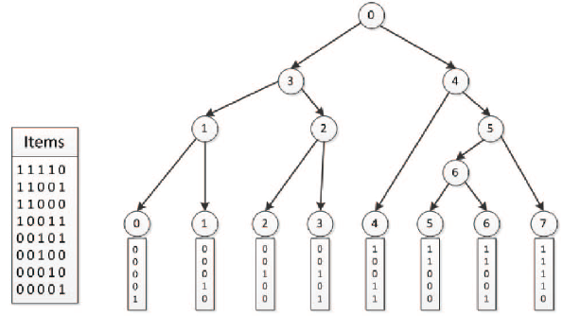
CUDA - Bitmap method
Item Mapping
A bitmap is generated to encode the relations between the transactions and frequent items
Parallelization Objective: Perform parallel processing of the bit encoding for multiple transactions
Radix Tree
Utilize shared prefixes to compress each transaction's encoding and insert it into the tree
Parallelization Objective: Simultaneously insert multiple transactions into the tree structure
Notes:
Item Mapping
產生點陣圖來編碼事務和頻繁項之間的關係
平行化目標：對多個交易的位編碼進行並行處理。
每個 CUDA 線程負責一個事務，通過 threadIdx.x 計算該事務的位向量。
Raidx Tree
利用共同前綴壓縮每個交易的編碼插入到樹中。
平行化目標：多個交易同時插入到樹結構中。
Item:
這邊用一筆一筆交易來看，每個id代表一筆交易，根據這個交易圖建成右邊這個bitmap。右圖要用直的來看，有購買就1沒買就0。所以有多少種item，block size就得多大。
FPtree:
要分成兩個部分來看，內節點跟葉節點，內節點會統計關聯數，葉節點是統計真正的交易數。
內節點是做分類並統計以下葉節點的交易數。
為什麼要這要做呢?原始的資料是一筆一筆的交易，這種的資料無法直接被cuda處理，所以要先做這個事前處理（16頁右上角）
另外，原本的樹是有多個degree的，這個樹只會有兩個分支，所以可能會建的比較深，時間也會稍微多一點，因為一個node只能分支兩次

Slide 17
Outline
Introduction/motivation
Proposed solution
Evaluation
Conclusion

Slide 18
Evaluation platform
Debian 12.6.0 with Intel(R) Core(TM) i5-10500 CPU @ 3.10GHz and Intel(R) Core(TM) i5-7500 CPU @ 3.40GHz processors
GeForce GTX 1060 6GB
g++-12, clang++-11, and CUDA 12.5.1

Slide 19
Datasets Setting
Datasets
Customers: 2000
Maximum purchase quantity: 10
Items Setting
Scenario 1: commodity category 50 items
Scenario 2: commodity category 100 items
Data Distribution Setting
Case1: Evenly distributed over all quantities
Case2: 20% High-purchasing-power、10% Moderate-purchasing-power、70% Low-purchasing-power
Case3: 70% High-purchasing-power、10% Moderate-purchasing-power、20% Low-purchasing-power

Slide 20





Datasets
種類少、買數少
種類多、買數少
種類少、買數多
種類多、買數多
Notes:
https://www.i-buzz.com.tw/article/article?atype=community&id=185 https://softwarecenter.pixnet.net/blog/post/47689718
https://online.visual-paradigm.com/tw/infoart/templates/logos/simple-logo-generated-for-planting-related-store/
https://www.teasney.com/
https://marketing.pxpayplus.com/pxplus_marketing_page/event?EventId=1000

Slide 21
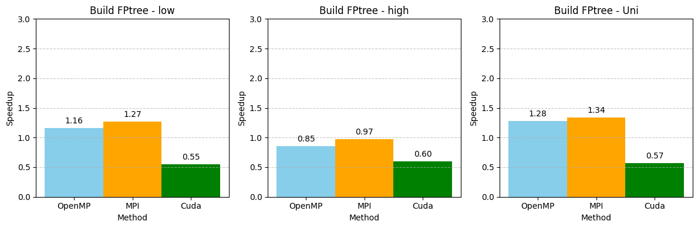
Evaluation Scenario 50 items

Slide 22
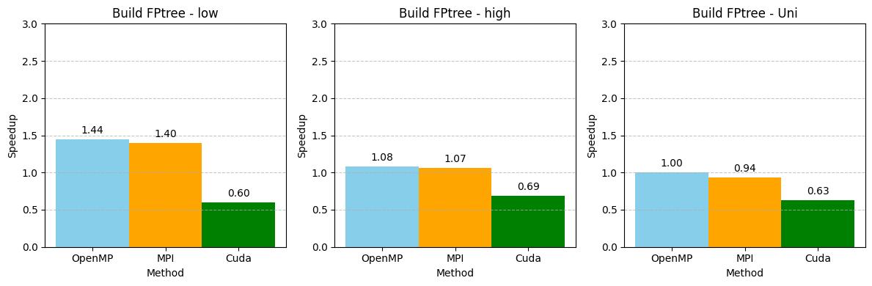
Evaluation Scenario 100 items

Slide 23
Outline
Introduction/motivation
Proposed solution
Evaluation
Conclusion

Slide 24
Conclusion
The FP tree structure is suitable for parallelization using OpenMP and MPI, but not suitable for CUDA with specific templates
The structure and shape of the FP tree also affect the effectiveness of parallelization

Slide 25
製作流程圖的順序
Step 1 - Calculate Minimum support
計算Minimum support數量
Step 2 - Find frequency of occurrence
統計各項Item的各項頻率
Step 3 - Prioritize the items
根據頻率排序各項Item的優先順位, 刪除不滿足最低支援要求的項目
Step 4 -Order the items according to priority
根據step3 對每一筆交易的item排序, 刪除不滿足最低支援要求的項目
Step 5 - Build Fp-tree
依序加入每筆交易資料建樹

Slide 26
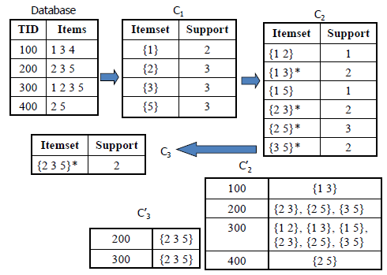
Apriori algorithm
Apriori uses a "bottom up" approach, where frequent subsets are extended one item at a time , and groups of candidates are tested against the data
Cons
At each step, candidate sets have to be built
To build the candidate sets, the algorithm
has to repeatedly scan the database

Slide 27
Evaluation
OpenMP - Build frequency item set
Threads | low_50 | low_100 | high_50 | high_100 | Uni_50 | Uni_100
1 | 0.3717 (ms) | 0.7803 (ms) | 0.6784 (ms) | 1.2187 (ms) | 0.4719 (ms) | 0.9007 (ms)
2 | 0.2852 (ms) | 0.6396 (ms) | 0.5491 (ms) | 0.7981 (ms) | 0.3821 (ms) | 0.7953 (ms)
4 | 0.2916 (ms) | 0.5105 (ms) | 0.5135 (ms) | 0.6739 (ms) | 0.3257 (ms) | 0.5783 (ms)

Slide 28
Evaluation
OpenMP - Build fptree
Threads | low_50 | low_100 | high_50 | high_100 | Uni_50 | Uni_100
1 | 6.1855 (ms) | 18.2161 (ms) | 12.6569 (ms) | 38.3971 (ms) | 7.2423 (ms) | 22.8133 (ms)
2 | 5.1155 (ms) | 14.3115 (ms) | 10.6069 (ms) | 31.6209 (ms) | 6.8525 (ms) | 21.2867 (ms)
4 | 4.1711 (ms) | 11.6468 (ms) | 9.5774 (ms) | 26.8144 (ms) | 5.4596 (ms) | 15.6145 (ms)

Slide 29
Evaluation
MPI - Build frequency item set
Processors | low_50 | low_100 | high_50 | high_100 | Uni_50 | Uni_100
1 | 0.3998 (ms) | 0.7071 (ms) | 0.556 (ms) | 1.1745 (ms) | 0.4491 (ms) | 0.8264 (ms)
2 | 0.2947 (ms) | 0.4936 (ms) | 0.3767 (ms) | 0.7386 (ms) | 0.3709 (ms) | 0.6535 (ms)
4 | 0.2796 (ms) | 0.6663 (ms) | 0.3424 (ms) | 0.5514 (ms) | 0.2401 (ms) | 0.3355 (ms)

Slide 30
Evaluation
MPI - Build fptree
Processors | low_50 | low_100 | high_50 | high_100 | Uni_50 | Uni_100
1 | 3.6489 (ms) | 11.4413 (ms) | 8.1908 (ms) | 24.0895 (ms) | 4.7729 (ms) | 14.608 (ms)
2 | 3.708 (ms) | 11.5622 (ms) | 8.355 (ms) | 25.0723 (ms) | 4.8563 (ms) | 15.0433 (ms)
4 | 3.8069 (ms) | 11.8783 (ms) | 8.5183 (ms) | 27.238 (ms) | 4.9789 (ms) | 17.021 (ms)

Slide 31
Evaluation
cuda - Build frequency item set
Processors | low_50 | low_100 | high_50 | high_100 | Uni_50 | Uni_100
1 | 0.3998 (ms) | 0.7071 (ms) | 0.556 (ms) | 1.1745 (ms) | 0.4491 (ms) | 0.8264 (ms)
2 | 0.2947 (ms) | 0.4936 (ms) | 0.3767 (ms) | 0.7386 (ms) | 0.3709 (ms) | 0.6535 (ms)
4 | 0.2796 (ms) | 0.6663 (ms) | 0.3424 (ms) | 0.5514 (ms) | 0.2401 (ms) | 0.3355 (ms)

Slide 32
Contributions of each member
 | 產生測試 資料 | Serial code I/O 改寫 | OpenMP 平行化加速 | MPI 平行化加速 | CUDA 平行化加速
楊鎮綸 | ✔ |  |  |  | ✔
孟羽真 |  | ✔ | ✔
徐劭廷 |  |  |  | ✔

